Slide 1

Gen AI – Based Data Profiling
Team : Data - Profiling
Girichandu Palakodeti
Jagadeesh Ganaparthi
Balaji Buddana Venkatesh Bandi
Praveen Lingampate

Slide 2
Problem Statement
Generate a Gen AI – based data profiling that can:
Extract, interpret, and refine regulatory reporting instructions to identify key data validation requirements.
Automatically generate profiling rules based on allowable values and cross relation between the elements using LLM or ML.
3. Generate executable validation code to assess whether the reported data conforms to the extracted rules.
4. Suggested remediation actions for flagged transactions/observations, including automated explanations for auditors.

Slide 3
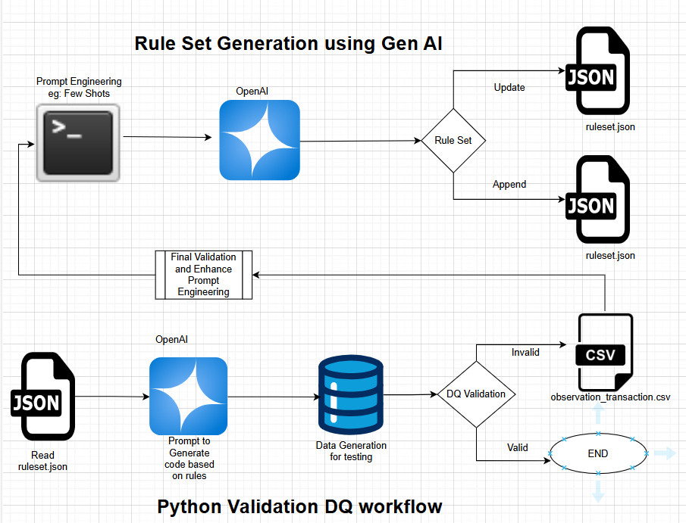
Architecture

Slide 4
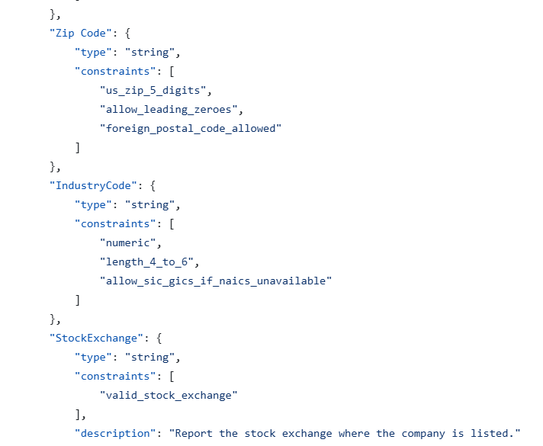
Architecture Components and Workflow
Sample ruleset
Step 1: Rule Set Generation using Gen AI:
Input:
The process starts with Prompt Engineering, using few-shot learning or other techniques to create structured prompts.
These prompts are sent to the OpenAI model to generate rule sets.
Output:
The generated rule set is saved in a ruleset.json file.
Two possible operations:
Update: Modify existing rules.
Append: Add new rules to the existing rule set.
Final Validation:
The generated rules undergo manual validation to verify accuracy and consistency.
The validation process may involve enhancing prompt engineering to refine the rule generation quality.

Slide 5
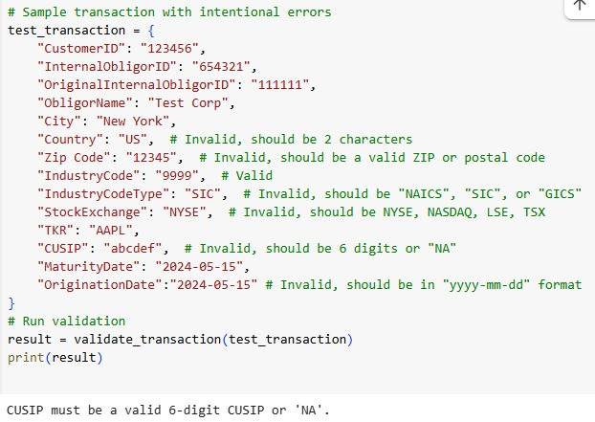
Contd
Sample validation result
Step 2: Python Validation DQ Workflow:
Input:
The validation pipeline reads the ruleset.json file containing the AI-generated rules.
It uses OpenAI to generate Python validation code based on the rules.
Test Data Generation:
The pipeline generates or imports sample datasets for testing.
DQ Validation Process:
The data quality validation is applied to the test data:
Valid records → Proceed to the final output.
Invalid records → Stored in observation_transactions.csv for review.
Output:
The validation process generates a final DQ validation report, indicating valid and invalid records.

Slide 6
Key Benefits of the Approach
Automation:
The rule generation process is automated using Generative AI, reducing manual intervention.
Dynamic Rule Set Management:
Supports both rule updates and append operations dynamically.
Invalid Record Tracking:
Invalid records are logged into observation_transactions.csv for further analysis.
Modular and Extensible:
The architecture is modular, allowing easy extension with additional validation steps or AI models.
Efficiency:
Automates the entire data quality validation workflow, reducing manual rule generation efforts.
Accuracy:
Enhances accuracy by using Gen AI for rule creation and applying prompt refinement techniques.

Slide 7
Contd
Scalability:
Python-based validation handles large datasets with efficient processing.
No need to hardcode rules into the validation logic.
New fields can be added by updating ruleset.
Uses dictionary-based value generators.
Adding a new field requires only modifying valid values.
Modular Validation Function
check_constraints() dynamically checks constraints without modifying validation logic.
Centralized Constraint Dictionary
No need to manually add new validation cases.
Simply define the constraint in ruleset, and check_constraints() will handle it.
.

Slide 8

Technologies Used
For generating ruleset and python validation code
For implementing the DQ pipeline
For storing rule sets/invalid transactions
For architecture diagram creation
OpenAI
Python
Json/csv
Draw.io

Slide 9

Thank You

